Slide 1

Visualization of Birds Strikes in 2000-2011

Slide 2
Introduction
Bird strikes pose a significant risk to aviation safety, causing substantial financial losses and potential hazards to aircraft and passengers. This analysis focuses on bird strike incidents in the United States between 2000 and 2011. By leveraging data visualization techniques in Tableau, we aim to uncover patterns, trends, and insights that can help mitigate risks and enhance aviation safety.

Slide 3
Details of Data
The data for this project is sourced from bird strike reports provided by the Federal Aviation Administration (FAA) and
other aviation authorities. The dataset contains detailed records of bird strike incidents, including:
Date and Time of Incident
Aircraft Type
Airport Name
Altitude at the Time of Strike
Number of Birds Struck
Impact on Flight
Flight Date
Damage Indicated
Number of Engines
Origin State
Phase of Flight
Remains of Wildlife Collected
Remarks
Wildlife Size
Sky Conditions
Altitude Bin
Number of People Injured
Cost of Incident

Slide 4
Main KPIs
Total Number of Bird Strikes
Yearly Bird Strikes
Monthly Bird Strikes
Top 10 Airlines by Bird Strikes
Top 50 Airports by Bird Strikes
Yearly Cost Incurred Due to Bird Strikes
Bird Strikes by Phase of Flight
Average Altitude at Bird Strike
Effect of Bird Strikes on Flights
Number of Injuries Due to Bird Strikes

Slide 5
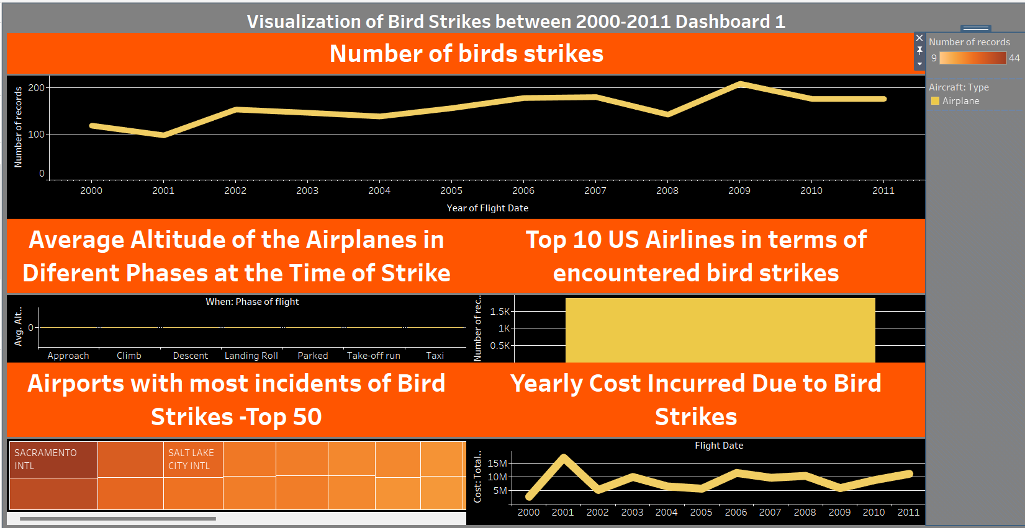
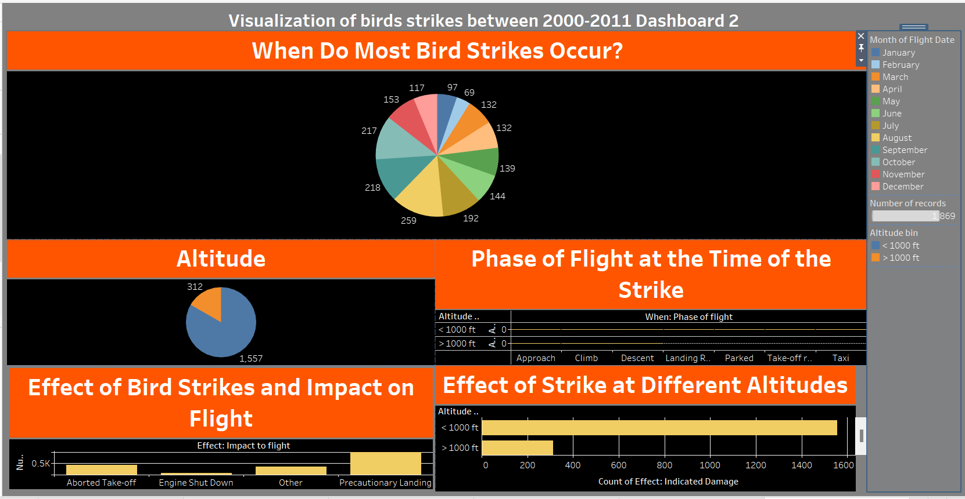
My Design

Slide 6
Thank you

